Slide 1
Ubuntu installation
Done by
K.Shivani(CSE(aiml)
M.Lavanya(ECE-3b)
M.Vivek Reddy(ECE-3b)
M.Manideep(CSE-3b)
S.Chenna Rao(ECE-3c)

Slide 2
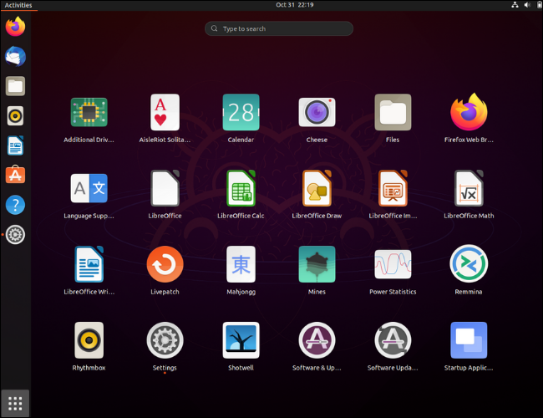
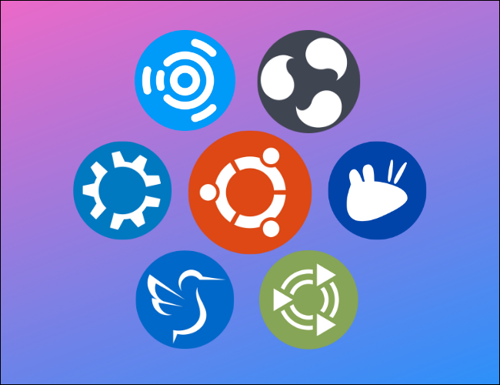
What is Ubuntu
Ubuntu is an open-source Linux-based operating system that is known for its ease of use, stability, and strong community support. It is developed and maintained by Canonical Ltd., a company founded by South African entrepreneur Mark Shuttleworth.

Slide 3
.
Ubuntu Philosophy: Ubuntu is built on the principles of open-source software, which means that its source code is freely available to the public. It follows the philosophy of promoting collaboration, community participation, and sharing.
Ubuntu Releases: Ubuntu follows a six-month release cycle, with a new version being released in April and October of each year. Each release has a version number consisting of the year and month of its release, such as Ubuntu 20.04 (released in April 2020) or Ubuntu 21.10 (released in October 2021).
Desktop Environment: Ubuntu offers several official flavors, each with a different desktop environment. The default desktop environment for Ubuntu is called GNOME

Slide 4
.
Software Packages: Ubuntu uses the Debian package management system, which allows users to easily install, update, and remove software packages. The Ubuntu Software Center and the command-line package manager called APT (Advanced Package Tool)
Long-Term Support (LTS) Releases: Every two years, Ubuntu releases a Long-Term Support (LTS) version, which is supported with security updates and bug fixes for five years on the desktop and ten years on the server.
Ubuntu Server: Ubuntu is widely used as a server operating system, offering robust features for web servers, file servers, database servers, cloud deployments, and more. Ubuntu Server includes tools such as LAMP (Linux, Apache, MySQL, PHP) stack, OpenStack.

Slide 5
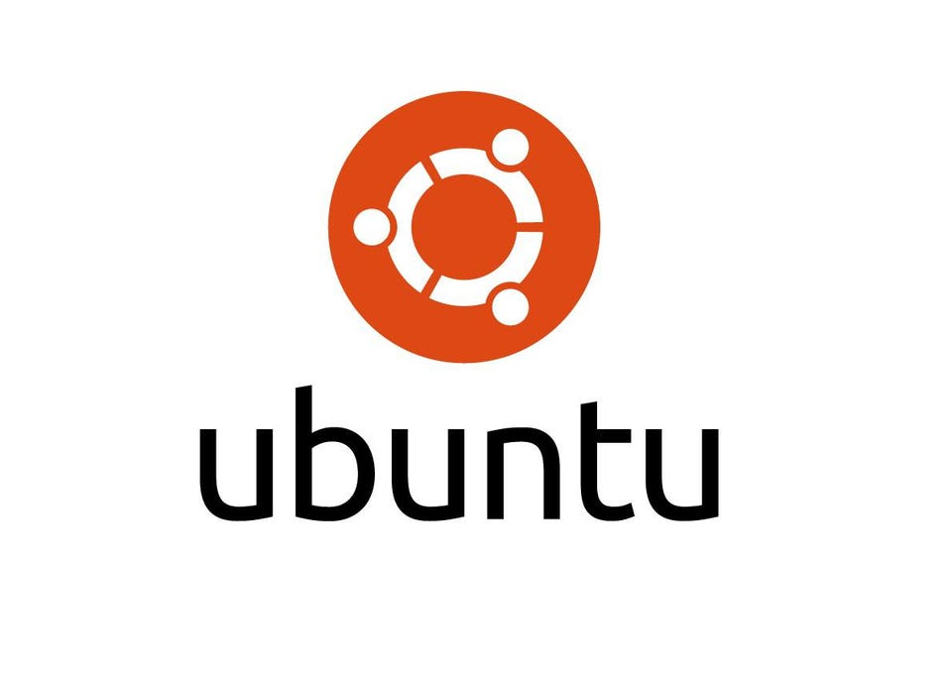
Steps to install Ubuntu
Download Ubuntu: Go to the official Ubuntu website (https://ubuntu.com/download) and download the version of Ubuntu that suits your needs. Choose between the long-term support (LTS) version or the latest version, depending on your preferences.

Slide 6
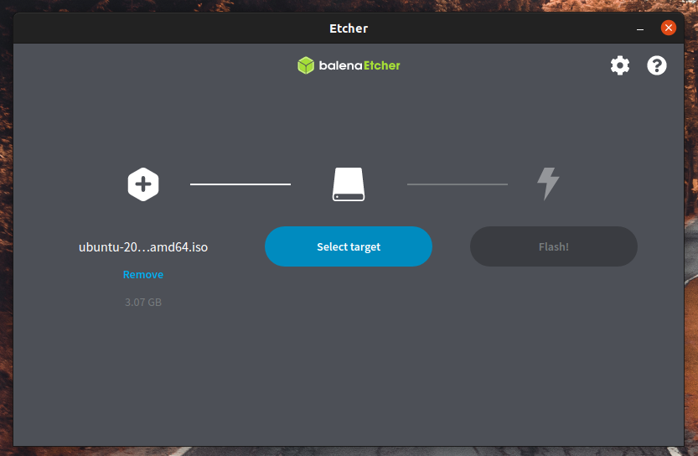
.
Create a bootable USB drive: After downloading the Ubuntu ISO file, you'll need to create a bootable USB drive. You can use a tool like Rufus (https://rufus.ie/) on Windows or the built-in "Disk Utility" on macOS to create the bootable USB drive. Follow the instructions provided by the tool to create the bootable USB drive.

Slide 7
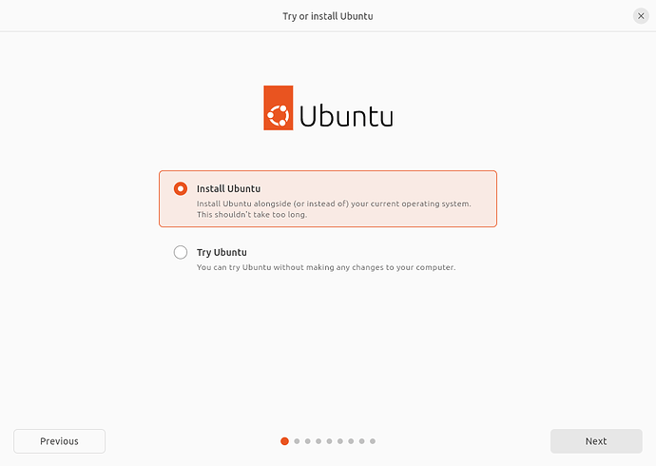
.
Boot from the USB drive: Insert the bootable USB drive into your computer and restart it. As the computer starts up, enter the BIOS or boot menu (usually by pressing F2, F12, or Delete key). In the BIOS or boot menu, set the USB drive as the primary boot device. Save the changes and exit the BIOS or boot menu.

Slide 8
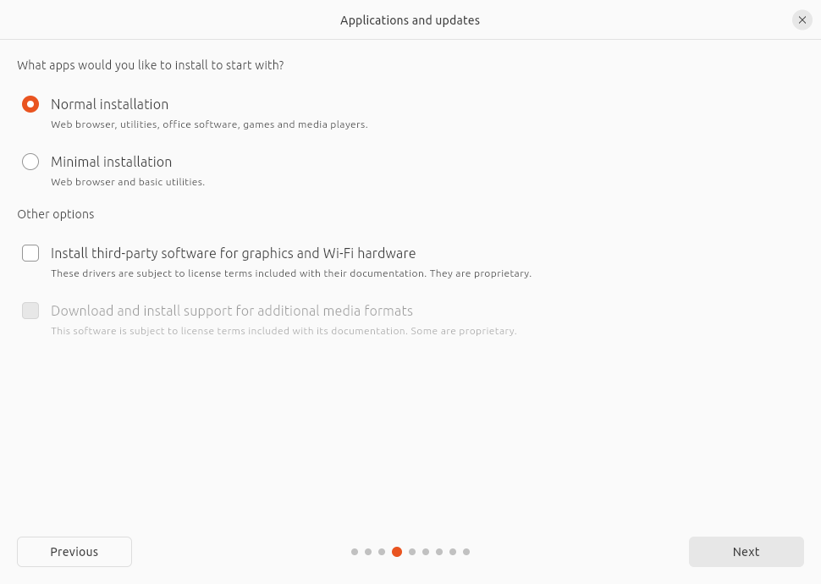
.
Install Ubuntu: Your computer will now boot from the USB drive. Ubuntu's installation wizard will appear. Select your language and click "Install Ubuntu." You can choose to install third-party software and updates during the installation process if desired.

Slide 9
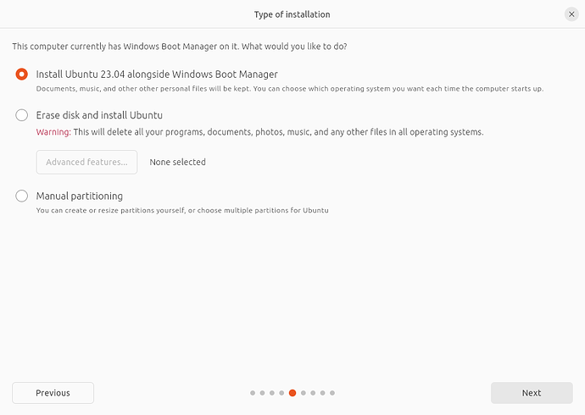
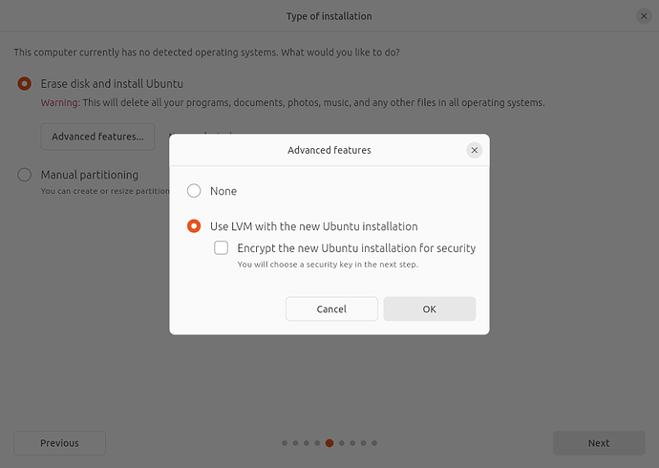
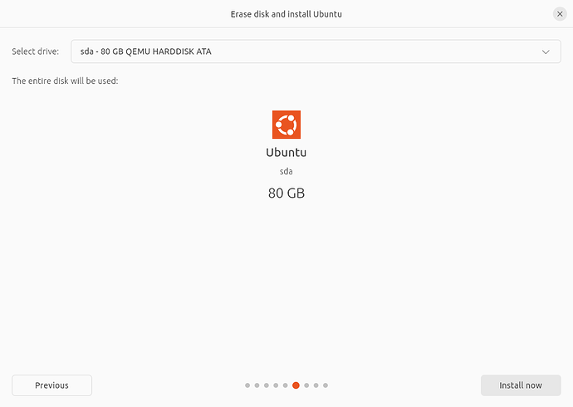
.
.
Partitioning: If you choose to install Ubuntu alongside an existing operating system, you'll need to allocate disk space for Ubuntu. Use the slider to adjust the partition sizes according to your needs. If you're erasing the disk, you can skip this step.

Slide 10
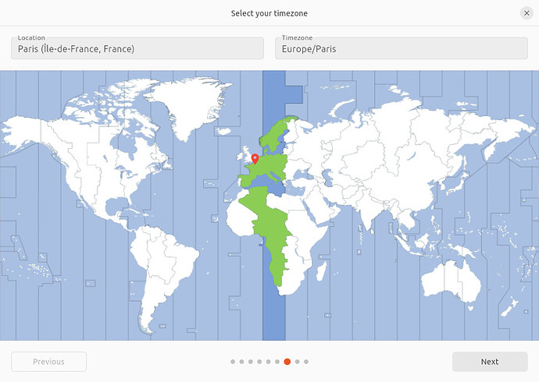
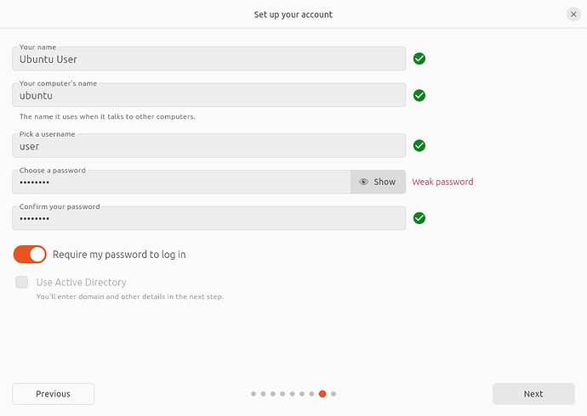
Select your location: Choose your location to set the time zone appropriately.
.
User information: Provide your name, a username, and a password for the user account you'll be using in Ubuntu.

Slide 11
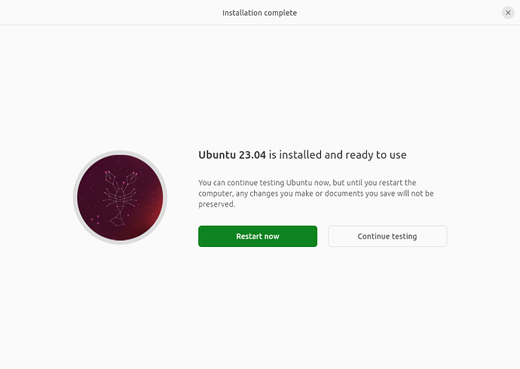
.
Wait for installation: Sit back and wait for Ubuntu to finish installing. The installation time may vary depending on your computer's speed and the version of Ubuntu you're installing.
Restart: Once the installation is complete, you'll be prompted to restart your computer. Remove the USB drive before restarting.
Welcome to Ubuntu: After restarting, you'll be greeted with the Ubuntu login screen. Enter your password to log in and start using Ubuntu.

Slide 12
Thank you
.

